Slide 1
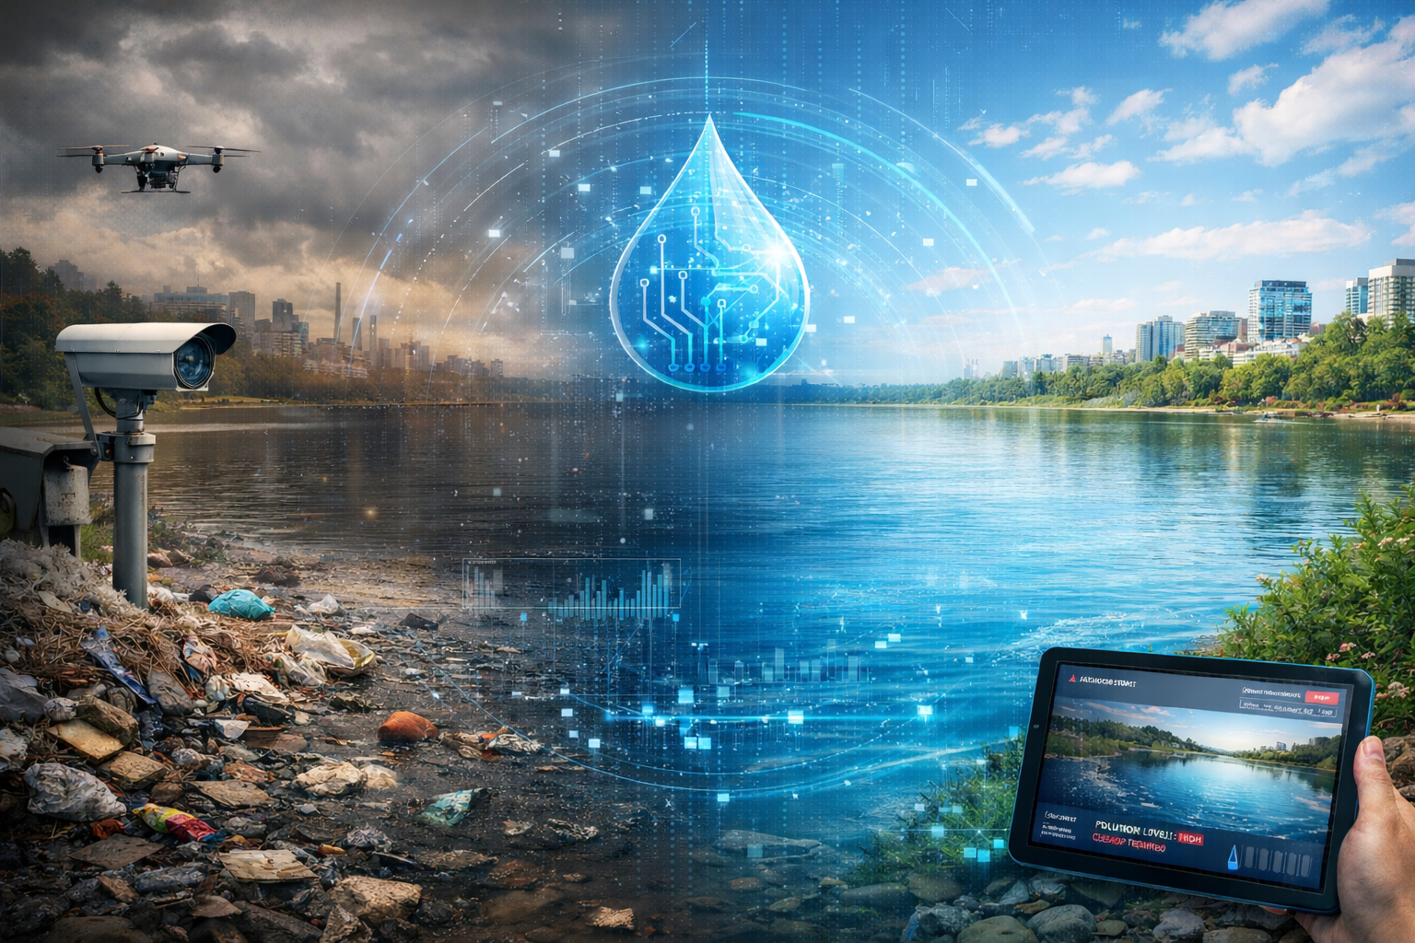

TITLE : AI-Driven Water Pollution Detection and Cleanup Decision Support System
COLLEGE NAME : ALLIANCE UNIVERSITY
STUDENT NAMES :
1. Basavaraj N S
2. Deva Shree B S
From dirty water to clean futures powered by AI

Slide 2



SDG ALLINGMENT
PRIMARY SDG :
SECONDARY SDGs :
Supports SDG 6 by detecting water pollution and enabling timely cleanups for safe and clean water
Protects aquatic life by reducing water pollution.
Improves environmental quality and public health through cleaner water bodies.

Slide 3
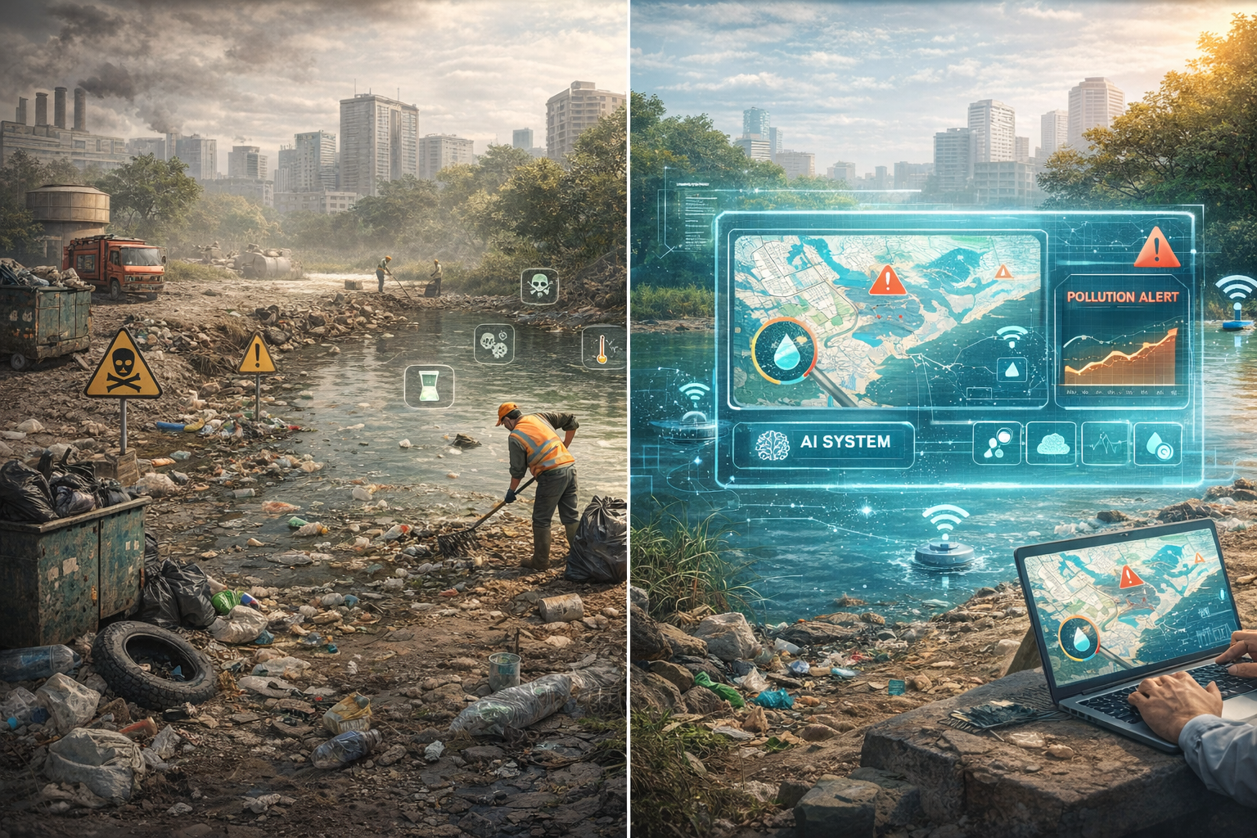
PROBLEM STATEMENT
Urban and semi-urban water bodies are increasingly polluted due to waste, untreated water, and irregular monitoring, posing risks to human health and aquatic life. Current cleanup efforts are manual, periodic, and reactive, lacking real-time data and prioritization. Authorities often miss the most polluted sites, leading to inefficient resource use. An AI-based system is needed for continuous monitoring, pollution detection, and data-driven cleanup planning

Slide 4
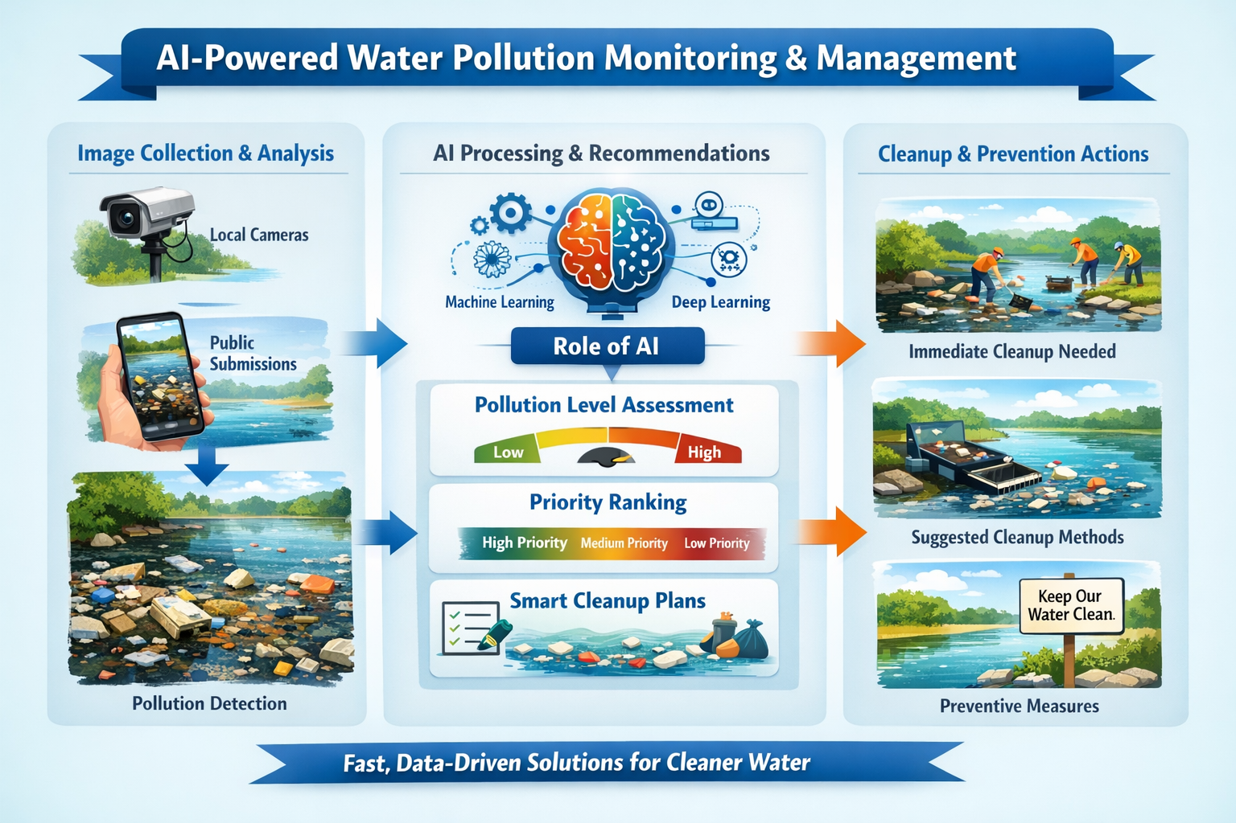
AI SOLUTION OVERVIEW
This project uses an AI-powered system to monitor and manage pollution in lakes, ponds, and other water bodies. Images are collected from the public and local cameras installed near water bodies. AI analyzes these images to detect visible pollution, like garbage and water discoloration, and assigns a pollution level to each water body.
Based on this analysis, the system recommends which water bodies need immediate cleanup, suggests possible cleanup methods, and offers preventive measures to reduce future pollution. By combining community participation, automated monitoring, and AI analysis, authorities can act faster, prioritize efforts better, and manage water bodies more efficiently.

Slide 5
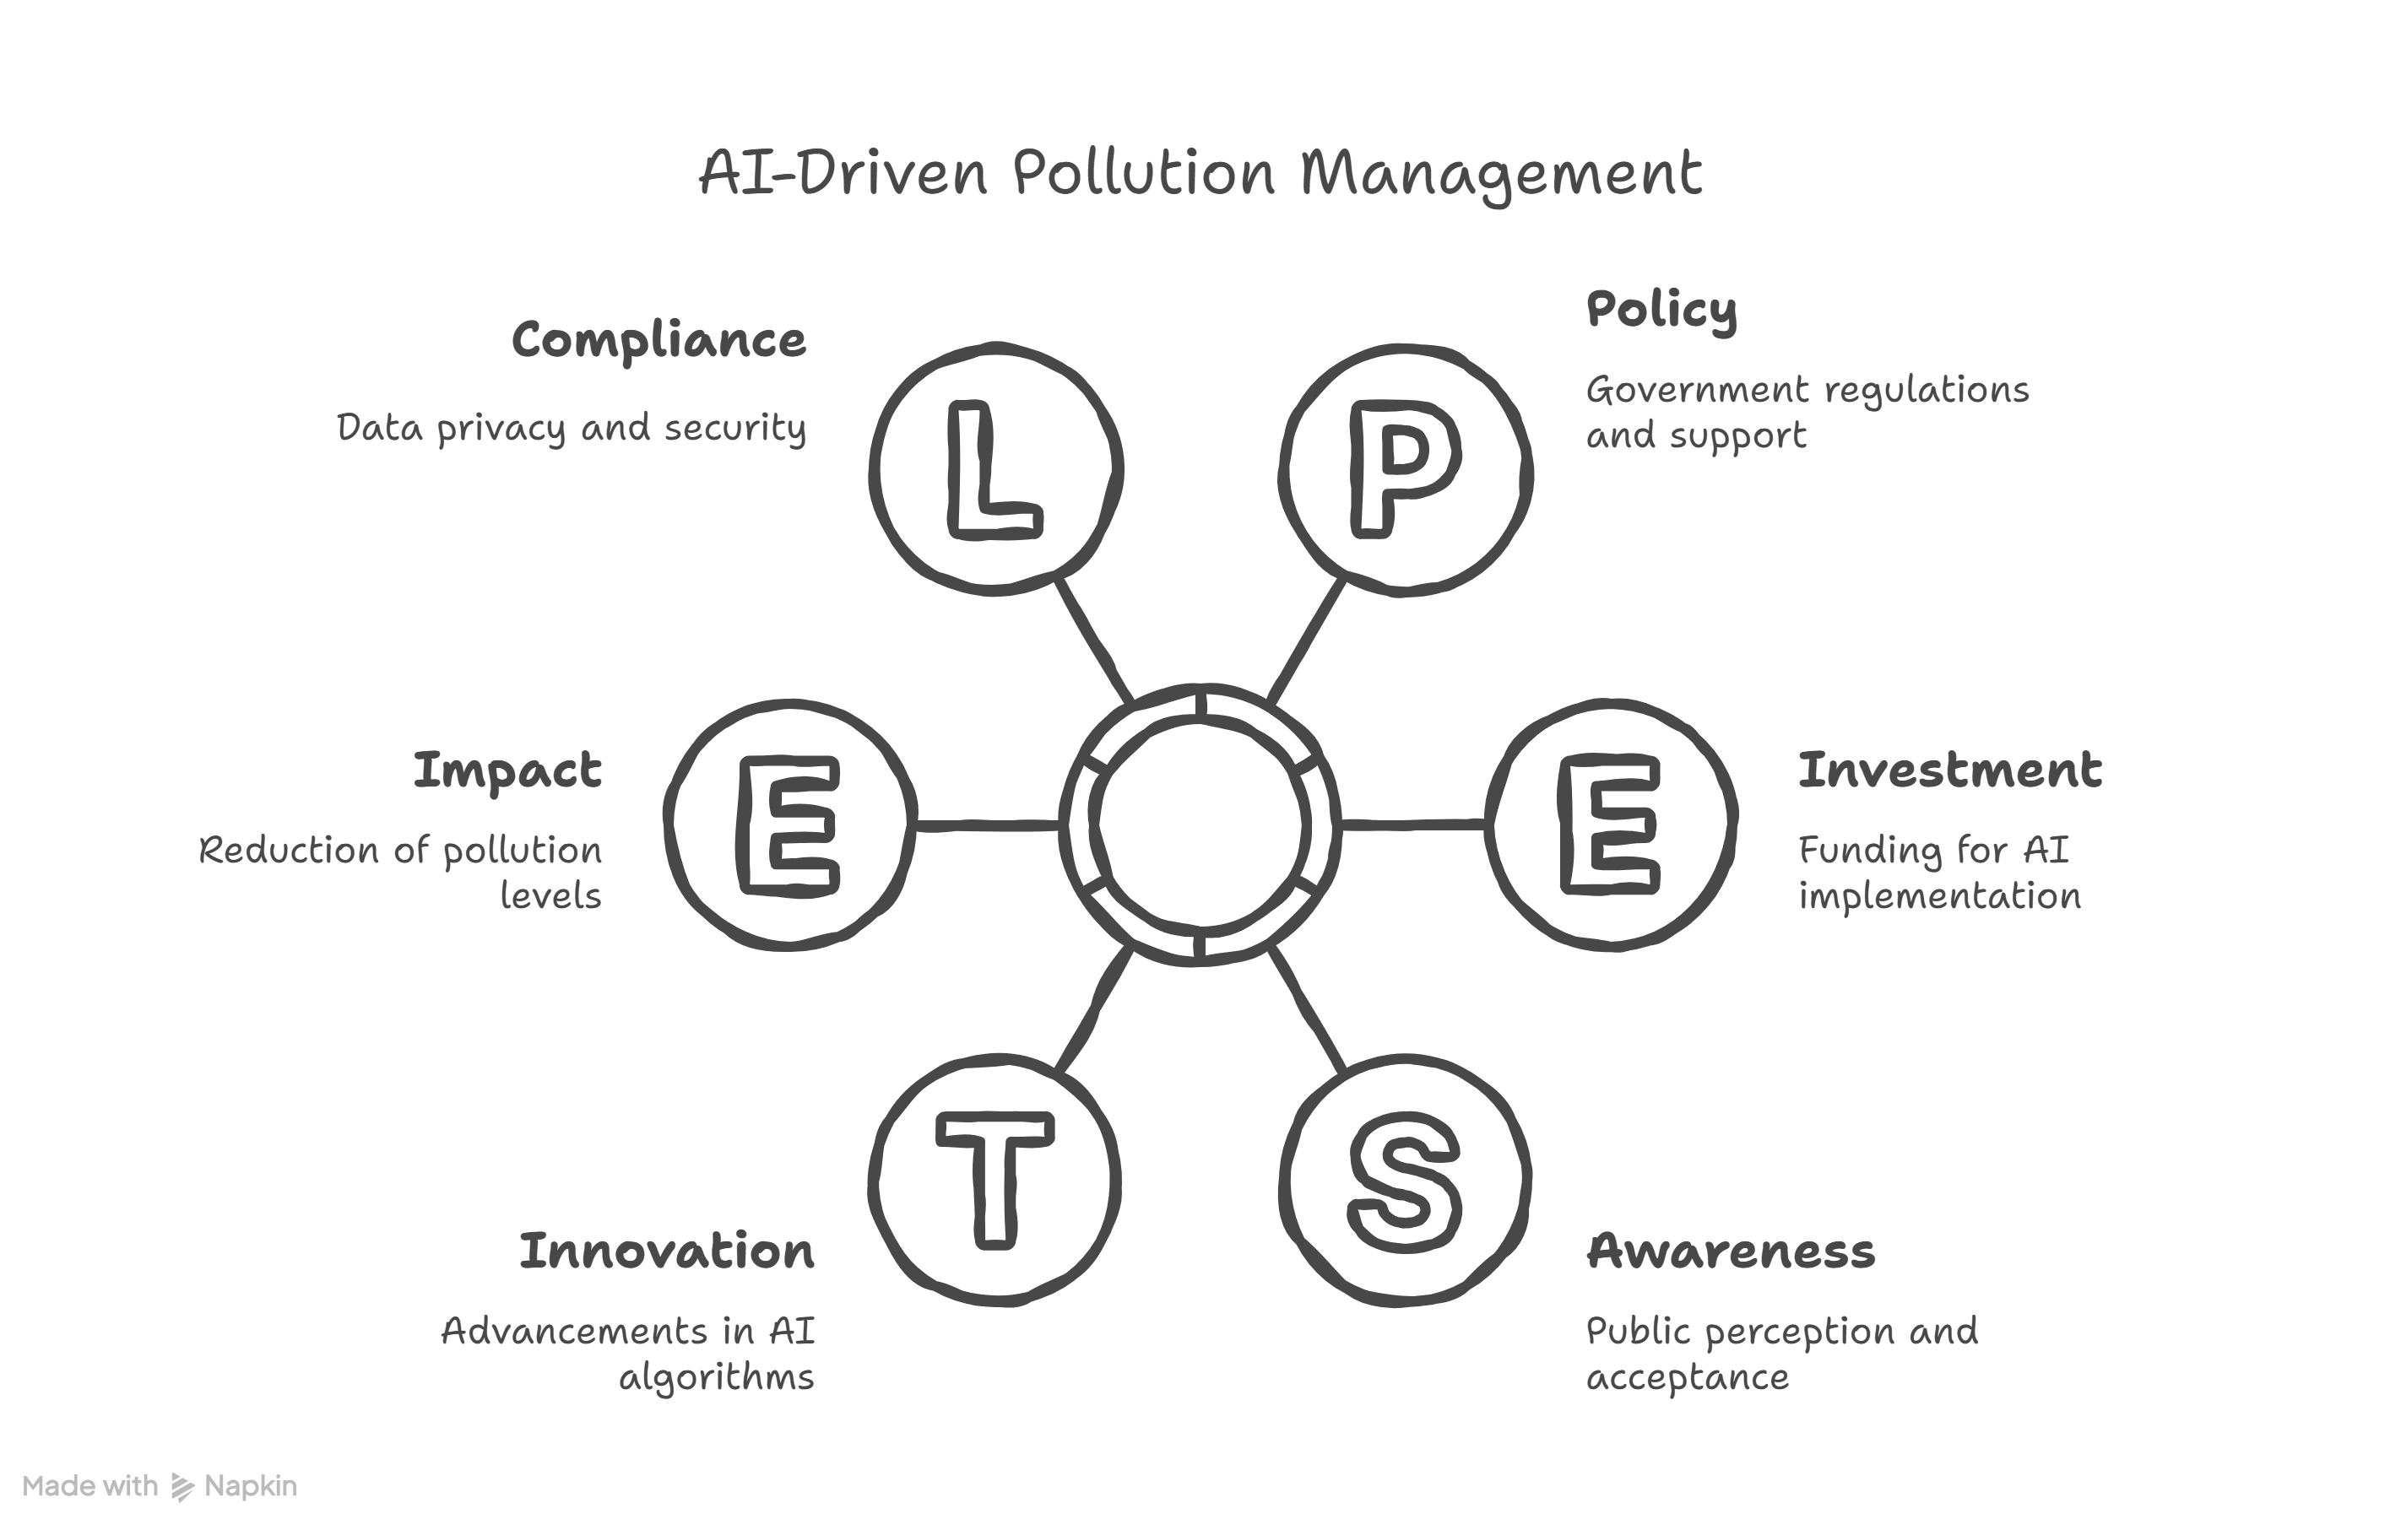
ROLES OF AI
AI is the brain of the system. Machine Learning and Deep Learning detect pollution signs in images, while Generative AI and RAG help provide smart recommendations by combining patterns from data with relevant knowledge. The AI classifies pollution severity, ranks water bodies by priority, and generates actionable cleanup plans. This allows authorities and cleanup teams to respond quickly and make informed, data-driven decisions.

Slide 6
TARGET USERS:
Primary Users:
Government authorities and local bodies responsible for managing and maintaining water bodies.
Secondary Users:
Environmental agencies, water management departments, and cleanup teams.
Indirect Beneficiaries:
Local communities and residents living near lakes, ponds, and tanks.

Slide 7
Responsible AI Considerations
This AI-based water pollution monitoring system is designed to support authorities ethically, transparently, and fairly:
1.Fairness: AI evaluates water bodies solely based on pollution indicators from images and sensor data, avoiding bias toward any region or community.
2.Transparency: The system clearly explains how pollution levels and priority rankings are determined, enabling authorities to verify results before acting.
3.Ethics: AI assists decision-making without replacing human judgment and avoids misleading claims, ensuring responsible use.
4. Privacy: No personal or sensitive user data is collected; uploaded images are used exclusively for environmental analysis.
By adhering to these principles, the project ensures safe, accountable, and equitable management of water resources, benefiting both authorities and local communities.

Slide 8
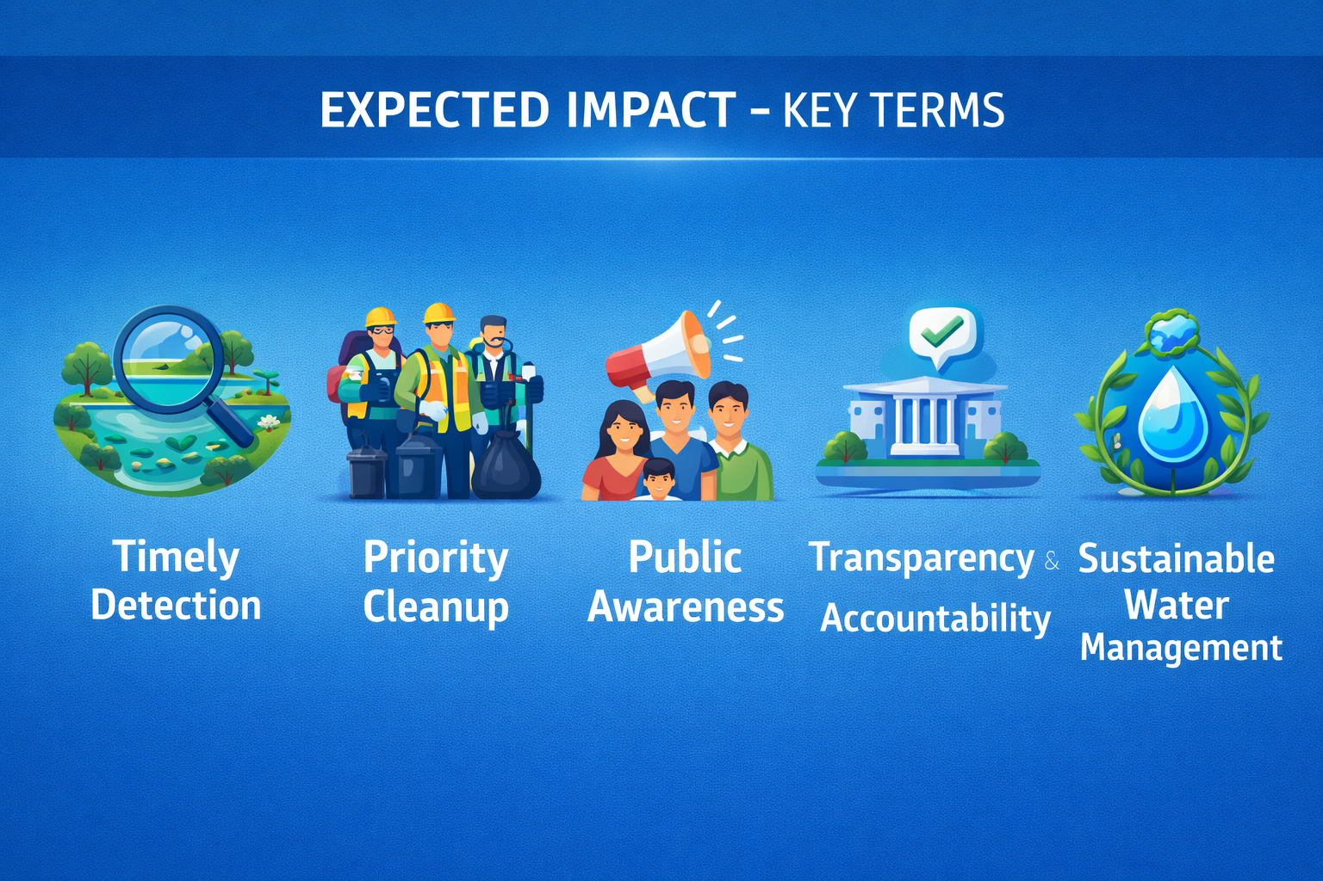
EXPECTED IMPACT :
This project helps authorities detect water pollution early and prioritize cleanup actions efficiently. It promotes cleaner water bodies, healthier ecosystems, and safer communities. It also increases public awareness and supports sustainable water management.
Expected Impact – Key Terms:
Timely Detection
Priority Cleanup
Public Awareness
Transparency & Accountability
Sustainable Water Management

Slide 9
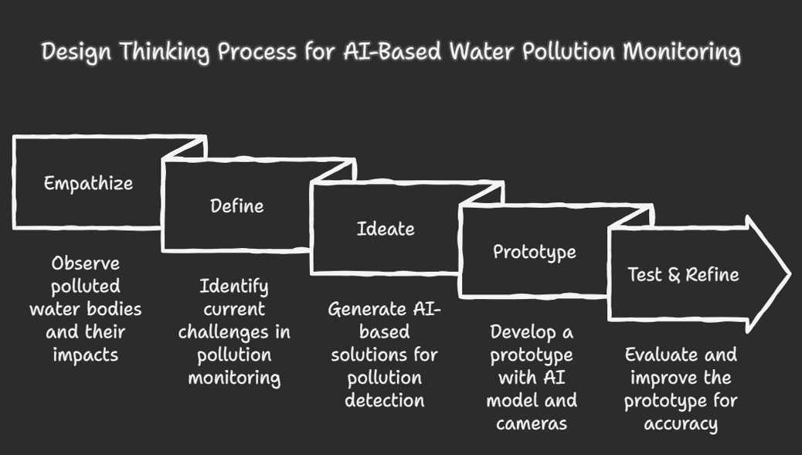

Slide 10
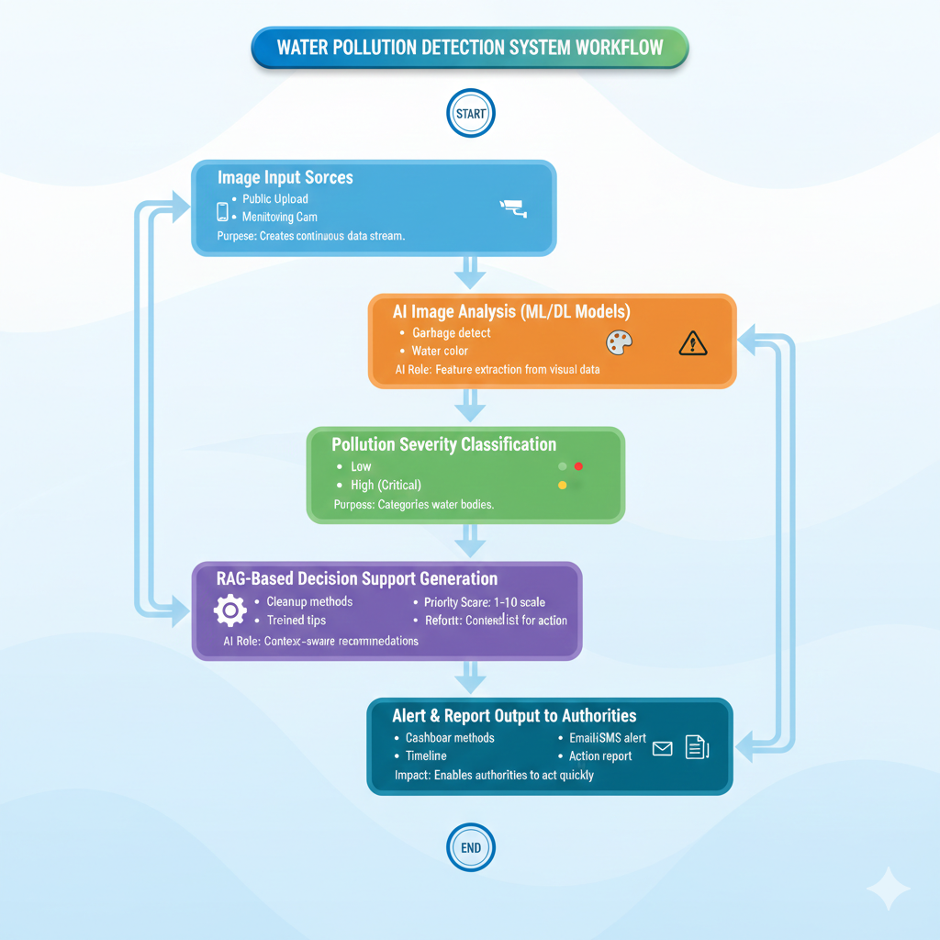
PROTOTYPE
This prototype shows an AI-based workflow for detecting water pollution and supporting cleanup decisions. It uses images from citizens and monitoring cameras around lakes, ponds, and tanks to turn visual data into useful insights for authorities, reducing the need for manual surveys.

Slide 11
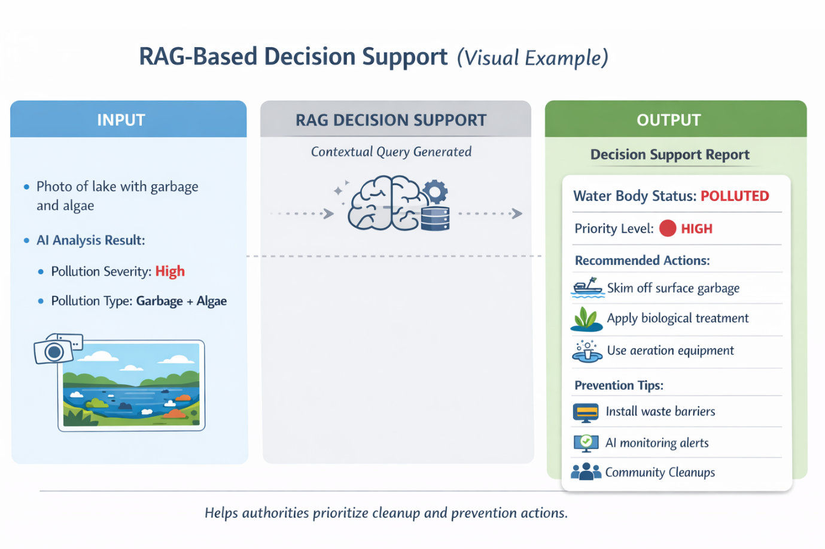
RAG DEMO
Retrieval-Augmented Generation.
RAG combines AI image analysis with water-management knowledge to provide context-based decisions. When an image shows pollution like garbage or algae, the system identifies severity and type, then suggests actions such as priority level, cleanup methods, and prevention steps. This example only demonstrates how decision support works.

Slide 12
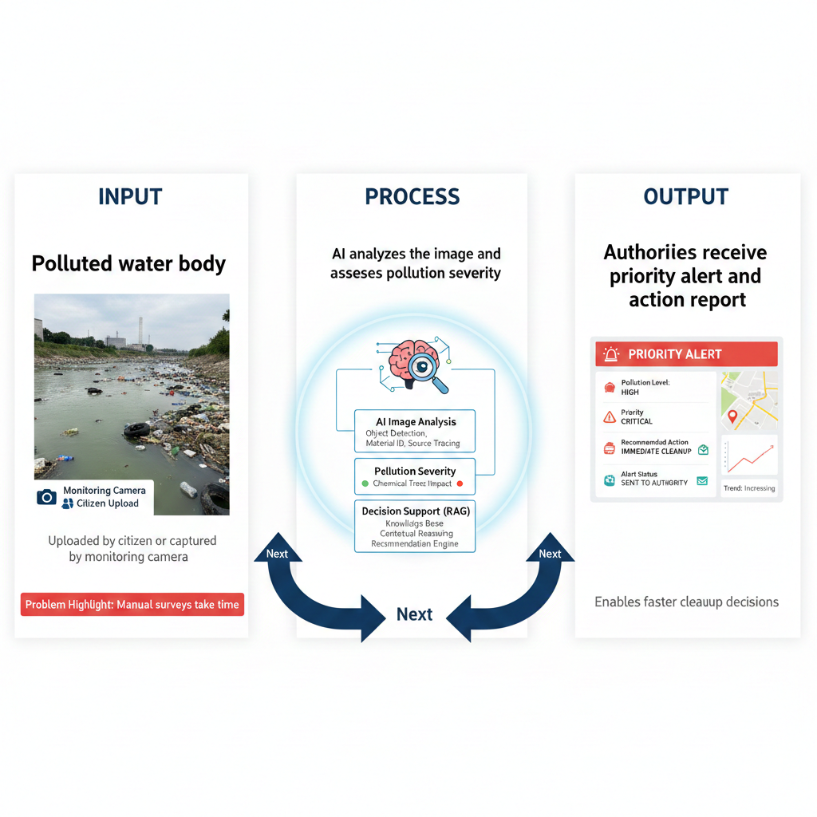
RAG-Based Decision Support
RAG combines AI image results with water-management knowledge.
It helps suggest actions based on pollution seen in images.
Input
AI analyzes images with garbage and algae.
It finds pollution level and type.
Output (Example)
Priority: High
Action: Immediate cleanup
Methods: Remove garbage, treat water, add oxygen
Prevention: Waste barriers, regular AI checks, public awareness
This is only a demo, not a real plan.

Slide 13
What Changes If The Solution Is Implemented
Polluted water bodies will be detected early.
Cleanup will happen faster and more efficiently.
Authorities will know which areas need urgent action.
Water quality will improve.
Health risks will reduce.
Who benefits and how?
Citizens get cleaner and safer water.
Government & local bodies get quick and accurate pollution data to act faster.
Environment & wildlife are protected from polluted water.
Communities become more aware and involved through image reporting.

